Slide 1
BITS Pilani
Dr. Lavika Goel
Assistant Professor
Department of CSIS
Pilani Campus

Slide 2
Pilani Campus
Principles of Programming Languages (CS F301)

Slide 3

Today’s Agenda
General course information
Objectives
Course Logistics
Course outline
Introduction to Principles of Programming Languages
Pilani Campus

Slide 4
General Course Information
Instructor-in-Charge: Dr. Lavika Goel
Instructors: Dr. Amit Dua <amit.dua@pilani.bits-pilani.ac.in>
Dr. Pratik Narang <pratik.narang@pilani.bits-pilani.ac.in>
Office: 6120-J
Email: lavika.goel@pilani.bits-pilani.ac.in
Chamber Consultation : Monday 11 AM -12 PM
Pilani Campus

Slide 5
Course Motivation
Reasons for studying concepts of programming languages
Increased capacity to express idea.
Improved background for choosing appropriate languages.
Increased ability to learn new language.
Better understanding of the significance of implementation.
Overall advancement of computing.
Pilani Campus
Notes:
Increased capacity to express ideas
– Learning new data structures, algorithms, and other language features will allow a programmer to create more efficient programs
• Example: after learning object-oriented programming in Java, a C programmer could simulate objects using structures and functions
Improved background for choosing appropriate languages
– Without having studied several different languages, programmers will tend to stick with the first language they learned
• Example: A C programmer might implement a binary tree with arrays, instead of using the object oriented capabilities of Java
Knowing the basic concepts of programming languages allows one to learn a new language easier
• Example: C++ or Ada programmers, who already understand the concept of object-oriented programming, will have an easier time of learning Java then programmers have never used these concepts
Better understanding of the significance of implementation
– Knowledge of the basic concepts of programming languages enables the programmer to make more efficient choices with implementation and to find bugs easier in a program
• Example: A C programmer who understands pointers can create the binary tree using structures and pointers, instead of with arrays, and will have an easier time debugging programs that use pointers
Overall advancement of computing
Knowing the advantages & disadvantages of different languages helps “those in charge” to choose better languages over poorer ones
• Example: In the early 1960s, Fortran was used much more than ALGOL 60, even though ALGOL 60 had much better control statements than Fortran

Slide 6
Programming Domains
Scientific Applications
Floating point arithmetic, Arrays and Matrices, loops and selection
FORTRAN, ALGOL 60
Business Applications
Reports, Decimal numbers and Character data, Decimal arithmetic
COBOl
Artificial Intelligence
Symbolic Computation mainly with names
Linked list
LISP, Prolog
Pilani Campus
Notes:
Increased capacity to express ideas
– Learning new data structures, algorithms, and other language features will allow a programmer to create more efficient programs
• Example: after learning object-oriented programming in Java, a C programmer could simulate objects using structures and functions
Improved background for choosing appropriate languages
– Without having studied several different languages, programmers will tend to stick with the first language they learned
• Example: A C programmer might implement a binary tree with arrays, instead of using the object oriented capabilities of Java
Knowing the basic concepts of programming languages allows one to learn a new language easier
• Example: C++ or Ada programmers, who already understand the concept of object-oriented programming, will have an easier time of learning Java then programmers have never used these concepts
Better understanding of the significance of implementation
– Knowledge of the basic concepts of programming languages enables the programmer to make more efficient choices with implementation and to find bugs easier in a program
• Example: A C programmer who understands pointers can create the binary tree using structures and pointers, instead of with arrays, and will have an easier time debugging programs that use pointers
Overall advancement of computing
Knowing the advantages & disadvantages of different languages helps “those in charge” to choose better languages over poorer ones
• Example: In the early 1960s, Fortran was used much more than ALGOL 60, even though ALGOL 60 had much better control statements than Fortran

Slide 7
Programming Domains
System Programming
Deals with low level features
UNIX
Scripting Languages
Initially began with collection of commands in a file and then followed by control statements , functions etc.
Java Script, PHP
Special Purpose Languages
Produce business reports, Instruct programmable Machine tools, System Simulation.
Pilani Campus
Notes:
Increased capacity to express ideas
– Learning new data structures, algorithms, and other language features will allow a programmer to create more efficient programs
• Example: after learning object-oriented programming in Java, a C programmer could simulate objects using structures and functions
Improved background for choosing appropriate languages
– Without having studied several different languages, programmers will tend to stick with the first language they learned
• Example: A C programmer might implement a binary tree with arrays, instead of using the object oriented capabilities of Java
Knowing the basic concepts of programming languages allows one to learn a new language easier
• Example: C++ or Ada programmers, who already understand the concept of object-oriented programming, will have an easier time of learning Java then programmers have never used these concepts
Better understanding of the significance of implementation
– Knowledge of the basic concepts of programming languages enables the programmer to make more efficient choices with implementation and to find bugs easier in a program
• Example: A C programmer who understands pointers can create the binary tree using structures and pointers, instead of with arrays, and will have an easier time debugging programs that use pointers
Overall advancement of computing
Knowing the advantages & disadvantages of different languages helps “those in charge” to choose better languages over poorer ones
• Example: In the early 1960s, Fortran was used much more than ALGOL 60, even though ALGOL 60 had much better control statements than Fortran

Slide 8
PL as a Course
What is not
Do not teach you a programming language
Do not teach you how to program
What is
Introduce fundamental concepts of programming languages
Discuss design issues of various language constructs
Examine design/implementation choices for these constructs
Compare design alternatives
Need to be familiar in at least one PL
Pilani Campus

Slide 9
Course Logistics
Pilani Campus

Slide 10
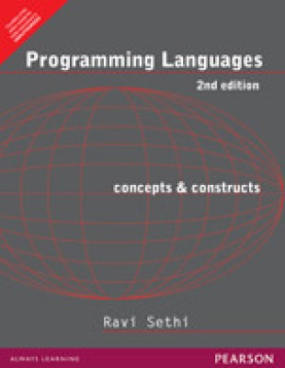
Text Book
Ravi Sethi, "Programming Languages: Concepts and Constructs" 2nd Edition by Addison Wesley.
Pilani Campus

Slide 11
Reference Books
[R1].Robert W. Sebesta, "Concepts of Programming Languages", 10th Edition by Pearson Publishers.
[R2]. Aho, Lam, Sethi and Ullman, "Compilers Principles, Techniques, and Tools". Pearson Education. Low Price Edition. 2004
Pilani Campus

Slide 12
Course Outline
Overview and motivation
Imperative Programming:
Describing Syntax and Semantics
Names, Bindings, and Scopes
Data Types
Expressions and Assignment
Control Structures
Subprograms
Object Oriented Programming: Abstract Data Types, Encapsulation, Information Hiding.
Functional and Logic Programming Languages
Pilani Campus

Slide 13
Course summary
Principles are emphasized more than details.
Methods are emphasized more than results.
Semantics is emphasized more than syntax.
Pilani Campus

Slide 14
What is a programming language?
A language that is intended for the expression of computer programs and that is capable of expressing any computer program.
Pilani Campus

Slide 15
Programming Language
A programming language is an artificial language designed to express computations or algorithms that can be performed by a computer
A program is computer coding of an algorithm that
Takes input
Performs some calculations on the input
Generates output
Input
Program
Output
Pilani Campus

Slide 16
Who Needs Programming Languages?
Computers' native tongue is machine language
Programmers need higher level languages, because:
They can't write machine language correctly
They can't read machine language fluently
They can't express their ideas in machine language efficiently
Life is too short to program in machine language.
A formal language is not only a man-machine interface but also a person-to-person language!
Pilani Campus

Slide 17
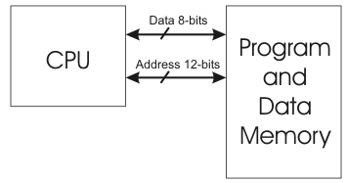
Von Neumann Architecture
Stored program concept
Data and instruction have same format
Interpret sequences as data and instructions
Pilani Campus

Slide 18
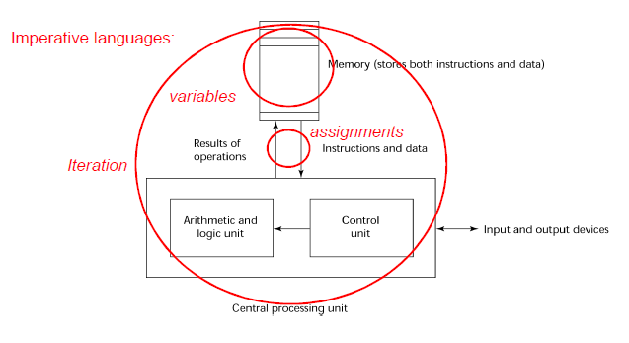
The von Neumann Architecture
Pilani Campus
Notes:
In a von Neumann computer, both data and programs are stored in the same memory. The central processing unit (CPU), which executes instructions, is separate from the memory. Therefore, instructions and data must be transmitted, or piped, from memory to the CPU. Results of operations in the CPU must be moved back to memory.

Slide 19
Imperative Lang. & von Neumann Architecture
Imperative languages, most dominant, because of von Neumann computers
Data and programs stored in memory
Memory is separate from CPU
Instructions and data are piped from memory to CPU
Basis for imperative languages
Variables model memory cells
Assignment statements model piping
Iteration is efficient
Pilani Campus

Slide 20
The von Neumann Architecture
Fetch-execute-cycle (on a von Neumann architecture computer)
initialize the program counter
repeat forever
fetch the instruction pointed by the counter
increment the counter
decode the instruction
execute the instruction
end repeat
Pilani Campus
Notes:
programs reside in memory but are executed in the CPU. Each instruction to be executed must be moved from memory to the processor. The address of the next instruction to be executed is maintained in a register called the program counter.
control transfers from the operating system to a user program for its execution and then back to the operating system when the user program execution is complete. In a computer system in which more than one user program may be in memory at a given time, this process is far more complex.

Slide 21
Language Categories
Imperative
Central features are variables, assignment statements, and iteration
Include languages that support object-oriented programming
Include scripting languages
Include the visual languages
Examples: C, Java, Perl, JavaScript, Visual BASIC, .NET, C++
Functional
Main means of making computations is by applying functions to given parameters
Examples: LISP, Scheme
Pilani Campus

Slide 22
Language Categories
Logic
Rule-based (rules are specified in no particular order)
Example: Prolog
Pilani Campus
Notes:
cat(tom) or cat(tom) :- true.
?- cat(tom). Yes
animal(X):- cat(X).
?- animal(X). X = tom

Slide 23
Programming Paradigms
Imperative – action oriented, sequence of actions.
Functional - symbolic data processing.
Object-Oriented - classes of objects.
Logic - logic reasoning.
Pilani Campus

Slide 24
Imperative Programming
General purpose imperative languages: Fortran, Pascal and C.
Fortran: Familiar notations and efficiency, machine language programs are more efficient as they do not require translation.
Language of choice for scientific programming: used mathematical notations, machine independent.
Algol 60 was developed as a common language to share programs and describe numerical processes- widely admired language.
Pascal was designed as a teaching language, similar to Algol 60 in syntactic constructs with minor differences.
C was developed as an implementation language for software for UNIX OS. C provides a rich set of operators, terse syntax and efficient access to the machine.
Pilani Campus

Slide 25
Functional Programming
LISP (list processor): language designed for applications in artificial intelligence.
Example of a List with 3 elements of which the third is a sublist-
(Shakespeare wrote (the tempest))
Designed primarily for symbolic data processing.
It has been used for symbolic calculations in differential and integral calculus, mathematical logic, game playing, etc.
Scheme: version of LISP popular for teaching and research due to its clean design.
Common LISP: is an advancement over proliferations of LISP i.e. MacLISP/ InterLISP. MacLISP emphasized performance and production quality while InterLISP introduced the notion of a programming environment with a structured editor tied to the syntax.
CLOS is an object oriented extension, Common Lisp Object System.
Other functional languages: ISWIM (not practically implemented), ML, Miranda, Haskell
Pilani Campus

Slide 26
Object oriented Programming
Key concept of OO Programming: class of objects, classification of objects into classes and subclasses (generalization and specialization).
Simula: Designed as both a programming language and a description language.
C++ and Smalltalk: popular OO languages, descendant of Simula by taking the notion of objects and classes.
C++ is an advancement over C which adds object oriented features to imperative programming in C.
Smalltalk was designed as part of personal computing environment, it is an interactive system with a graphical user interface.
Pilani Campus

Slide 27
Logic Programming
Prolog: was developed for natural language processing.
It uses a specialized form of logical reasoning to answer queries.
Used for a variety of applications from databases to expert systems.
Prolog programs have the expressiveness of logic.
Pilani Campus

Slide 28
A short history of programming Languages
1950s : LISP, FORTRAN
1960s : AlGOL 60, ISWIM, Simula
1970s : C, Pascal, Prolog, Smalltalk
During 1970 : a lot of PLs were designed.
1980s : C++, ML, Miranda, Haskell, CommonLISP
Numerically based languages. (FORTRAN,ALGOL)
Business languages. (COBOL)
Artificial intelligence languages. (LISP, Prolog)
Systems languages. ( C)
Pilani Campus

Slide 29
A short history of programming languages (cont.)
50s and 60s :
Early high level languages : FORTRAN, COBOL, ALGOL60
Early functional languages : LISP
Next leap forward: Algol68, SIMULA67, BASIC
70s:
High level and structured programming: Pascal
Systems programming: C, modula-2
Logical programming: Prolog
Improvement of functional programming: Scheme
Pilani Campus

Slide 30
A short history of programming languages (cont.)
80s:
Development of functional programming: CommonLisp, ML, Haskell, Miranda
Need for reliability and maintainability: Ada
Object-oriented programming: Smalltalk, C++
90s:
Fourth-generation languages
Visual languages : Delphi
Scripting languages : Perl
Pilani Campus

Slide 31
What Makes a Good PL?
Language evaluation criteria:
Readability: the ease with which programs can be read and understood
Writability: the ease with which a language can be used to create programs
Reliability: a program performs to its specifications under all conditions
Cost
Pilani Campus

Slide 32
Language Evaluation Criteria
 | CRITERIA
Characteristic | READABILITY | WRITABILITY | RELIABILITY
Simplicity | X | X | X
Orthogonality | X | X | X
Data types | X | X | X
Syntax design | X | X | X
Support for abstraction |  | X | X
Expressivity |  | X | X
Type checking |  |  | X
Exception handling |  |  | X
Restricted aliasing |  |  | X
Pilani Campus
Notes:
A lack of orthogonality leads to exceptions to the rules of the language.
For example, in a programming language that supports pointers, it should be possible to define a pointer to point to any specific type defined in the language. However, if pointers are not allowed to point to arrays, many potentially useful user-defined data structures cannot be defined.
The presence of adequate facilities for defining data types and data structures in a language is another significant aid to readability. For example, suppose a numeric type is used for an indicator flag because there is no Boolean type in the language.
Syntax Design
Special words.
Form and meaning
C, for example, the meaning of the reserved word static depends on the context of its appearance.
Writability
Writability is a measure of how easily a language can be used to create programs for a chosen problem domain.
Support for Abstraction
Briefly, abstraction means the ability to define and then use complicated structures or operations in ways that allow many of the details to be ignored.
A program is said to be reliable if it performs to its specifications under all conditions.
Type checking is simply testing for type errors in a given program, either by the compiler or during program execution. Type checking is an important factor in language reliability.
aliasing is having two or more distinct names that can be used to access the same memory cell.
aliasing—for example, two pointers set to point to the same variable, which is possible in most languages. In such a program, the programmer must always remember that changing the value pointed to by one of the two changes the value referenced by the other

Slide 33
Features Related to Readability
Overall simplicity: language is more readable if
Fewer features and basic constructs
Readability problems occur whenever program’s author uses a subset different from that familiar to reader
Fewer feature multiplicity (i.e., doing the same operation with different ways)
Minimal operator overloading
Orthogonality
A relatively small set of primitive constructs can be combined in a relatively small number of ways
The combination is legal.
Too much orthogonality can also cause problems
Pilani Campus

Slide 34
Features Related to Readability
Control statements
Sufficient control statements for structured prog. → can read program from top to bottom w/o jump
Data types and structures
Adequate facilities for defining data type & structure
Syntax considerations
Identifier or keywords
Special words and methods of forming compound statements
Form and meaning: self-descriptive constructs, meaningful keywords
Pilani Campus

Slide 35
Writability
Simplicity and orthogonality
But, too orthogonal may cause errors undetected
Support for abstraction
Ability to define and use complex structures or operations in ways that allow details to be ignored
Abstraction in process (e.g. subprogram), data
Expressivity
A set of relatively convenient ways of specifying operations
Example: the inclusion of for statement in many modern languages
Pilani Campus

Slide 36
Reliability
Type checking
Testing for type errors, e.g. subprogram parameters
Exception handling
Intercept run-time errors & take corrective measures
Aliasing
Presence of two or more distinct references for the same memory location
Readability and writability
A language that does not support “natural” ways of expressing an algorithm will necessarily use “unnatural” approaches, and hence reduced reliability
Pilani Campus

Slide 37
Cost
Training programmers to use language
Writing programs (closeness to particular applications)
Compiling programs
Executing programs: run-time type checking
Language implementation system: availability of free compilers
Reliability: poor reliability leads to high costs
Maintaining programs
Pilani Campus

Slide 38
Language Design Trade-Offs
Reliability vs. cost of execution
e.g., Java demands all references to array elements be checked for proper indexing but that leads to increased execution costs
Readability vs. writability
e.g., use of many powerful operators (and a large number of new symbols), allowing complex computations to be written in a compact program but at the cost of poor readability
Writability (flexibility) vs. reliability
e.g., C++ pointers are powerful and very flexible but not reliably used
Pilani Campus

Slide 39
Language Implementation
Compiler - source code translation into machine code (all at once)
Interpreter - machine is brought up to the language (one statement at a time)
Pilani Campus

Slide 40
Implementation Methods
Compilation
Programs are translated into machine language.
Pure Interpretation
Programs are interpreted by another program known as an interpreter.
Hybrid Implementation Systems
A compromise between compilers and pure interpreters.
Pilani Campus

Slide 41
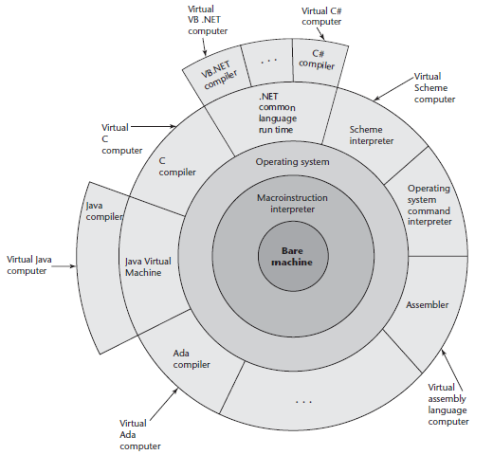
Layered View of Computer
The operating system and
Language implementation are layered over machine interface of a computer
Pilani Campus

Slide 42
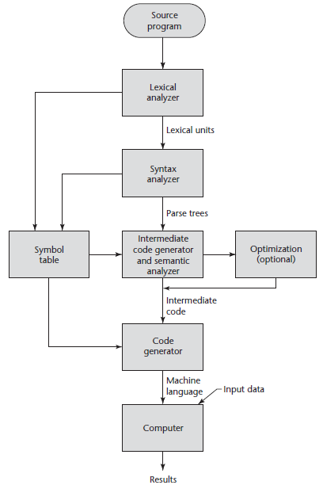
The Compilation
Process
Pilani Campus

Slide 43
Compilation
Translate high-level program (source language) into machine code (machine language).
Compilation process has several phases:
lexical analysis: converts characters in the source program into lexical units e.g.: identifiers / keywords, operators, punctuation…
syntax analysis: transforms lexical units into parse trees which represent the syntactic structure of program.
Intermediate code generation & Semantics analysis: generate intermediate code and does type checking.
Code optimization: (optional)
code generation: machine code is generated.
Pilani Campus

Slide 44
Additional Compilation Terminologies
Load module (executable image):
the user and system code together.
Linking and loading:
the process of collecting system program units and linking them to a user program.
As well as linking other user programs to it.
Pilani Campus

Slide 45
Compiled C
Source
code
in C
.o
files
compiler
Linker
and
loader
Machine
code (exe)
Pilani Campus

Slide 46
Pure Interpretation
• No translation
Program interpreted by another program (interpreter) without translation
Interpreter acts a simulator or virtual machine
Machine is brought to the level of language by building higher level machine called an interpreter that can run the language directly.
• Easier implementation of programs (run-time errors can easily and immediately be displayed)
• Slower execution (10 to 100 times slower than compiled programs)
Decoding of higher level language programs is more complex, decoding has to be done every time a statement is executed.
• Often requires more space
• Used in APL, SNOBOL, LISP.
Now rare for traditional high-level languages
• Significant comeback with some Web scripting languages (e.g., JavaScript, PHP)
Pilani Campus
Notes:
The primary source of this slowness is the decoding of the high-level language statements, which are far more complex than machine language instructions (although there may be fewer statements than instructions in equivalent machine code).
Furthermore, regardless of how many times a statement is executed, it must be decoded every time. Therefore, statement decoding, rather than the connection between the processor and memory, is the bottleneck of a pure interpreter.
Another disadvantage of pure interpretation is that it often requires more space.
In addition to the source program, the symbol table must be present during interpretation.
APL, SNOBOL, and LISP
However, in recent years, pure interpretation has made a significant comeback with some Web scripting languages, such as JavaScript and PHP, which are now widely used.

Slide 47
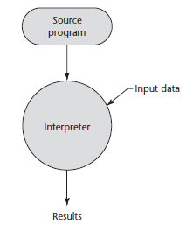
Pure Interpretation Process
Pilani Campus

Slide 48
Comparisons
Interpretation is slower as decoding of higher level language programs is more complex, decoding has to be done every time a statement is executed.
Compiled languages have bias towards static properties since all compiling decisions are made at translation time. Interpreted languages can deal with dynamic properties.
Interpretation is more flexible: due to direct running on the source code, interpreter can allow to add features or correct errors in the source code.
Pilani Campus

Slide 49
Hybrid Implementation Systems
A compromise between compilers and pure interpreters.
A high-level language program is translated to an intermediate language that allows easy interpretation.
Faster than pure interpretation since the source language statements are decoded only once.
Examples
Perl programs are partially compiled to detect errors before interpretation.
Initial implementations of Java were hybrid;
the intermediate form, byte code, provides portability to any machine that has a byte code interpreter and a run-time system (together, these are called Java Virtual Machine).
Pilani Campus
Notes:
Hybrid Implementation Systems translate high-level language programs to an intermediate language designed to allow easy interpretation.
Instead of translating intermediate language code to machine code, it simply interprets the intermediate code.
Perl is implemented with a hybrid system. Perl programs are partially compiled to detect errors before interpretation and to simplify the interpreter.
Initial implementations of Java were all hybrid. Its intermediate form, called byte code, provides portability to any machine that has a byte code interpreter and an associated run-time system. Together, these are called the Java Virtual Machine. There are now systems that translate Java byte code into machine code for faster execution.
A Just-in-Time ( JIT) implementation system initially translates programs to an intermediate language. Then, during execution, it compiles intermediate language methods into machine code when they are called. The machine code version is kept for subsequent calls. JIT systems are now widely used for Java programs. Also, the .NET languages are all implemented with a JIT system.

Slide 50
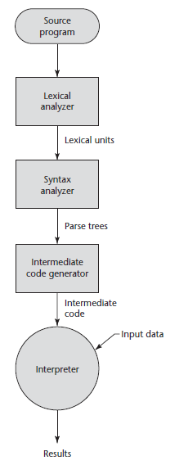
Hybrid Implementation Process
Pilani Campus

Slide 51
Just-in-Time Implementation Systems
Initially translate programs to an intermediate language.
Then compile the intermediate language of the subprograms into machine code when they are called Machine code version is kept for subsequent calls.
JIT systems are widely used for Java programs.
.NET languages are implemented with a JIT system.
Pilani Campus

Slide 52
Summary
The study of programming languages is valuable for a number of reasons:
Increase our capacity to use different constructs
Enable us to choose languages more intelligently
Makes learning new languages easier
Most important criteria for evaluating programming languages include:
Readability, writability, reliability, cost
Major influences on language design have been
machine architecture and software development methodologies
The major methods of implementing programming languages are:
compilation, pure interpretation, and hybrid implementation
Pilani Campus

